Slide 1
Deep learning for compression of data in quantum computing
Quantum C2C

Slide 2
TEAM PRESENTATION
Chih-Han (Robin) Huang Data Scientist
Deep Learning, Quantum Computing
Sumitra Pundlik Professor
Quantum Computing, Data Science
Khushwant Kumar Engineer
Deep learning, Quantum Computing

Slide 3
Data compression in previous literatures
Classical data
Dimension reduction
Classical data with low dimension
Simple or non-parametric
Downsampling image resolutions
Principal components analysis
Quantum encoding
Quantum data
Quantum computing/Quantum machine learning
Result

Slide 4

Suitable for any quantum circuit?
Information loss?

Slide 5

Designing a data compression model for your own quantum circuit!
Quantum C2C

Slide 6
Autoencoder
Classical training data
Encoder
Classical training data with low dimension
Decoder
Reconstructed data

Slide 7
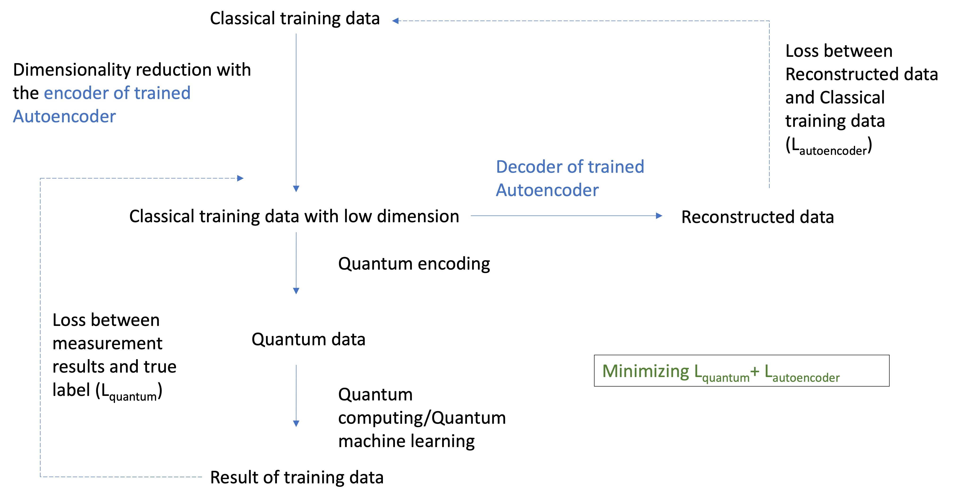

Slide 8
Thanks for your listening

